Slide 1
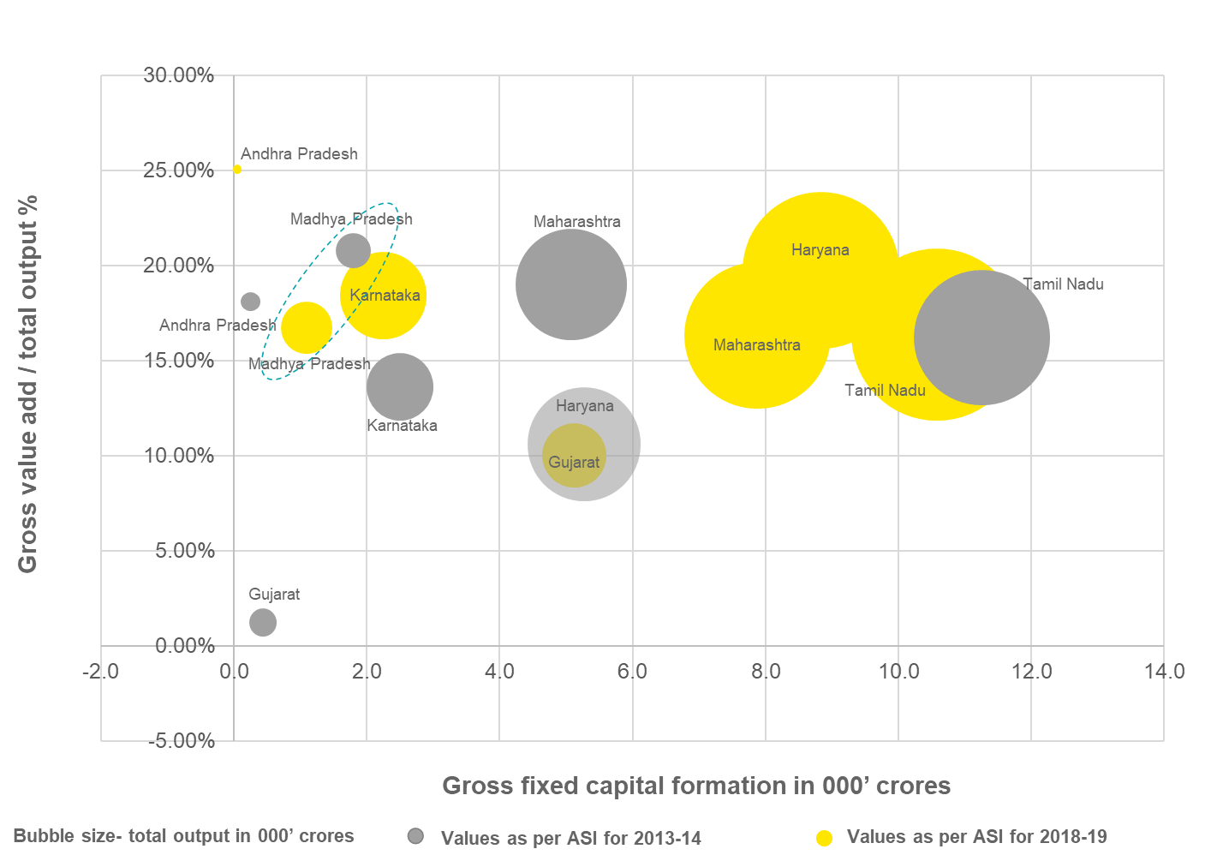
Analysis of Madhya Pradesh’s sectoral performance Illustrative: Automotive Sector
The percentage of Gross Value add to total output in automotive sector for Madhya Pradesh has increased in 5 years from 2014. However, the increase in gross fixed capital formation signifies that there hasn't been significant increase in investment in the sector.
Gujarat has shown a substantial increase in the investment and value add size increase.
While, Maharashtra, Tamil Nadu and Haryana have been forerunners in the automotive sector.
Madhya Pradesh needs to attract the large high GVA fetching units within the automotive sector to increase its standpoint amongst competitive states.

